Slide 1











Thanks to our Sponsors!
Yearly Partners
Gold Sponsors
Silver Sponsors
Blogger Sponsors: @SQLvariant

Slide 2
How to not kill your cool insight with a bad graph: ggplot and other visualization tips
Seth Paul

Slide 3
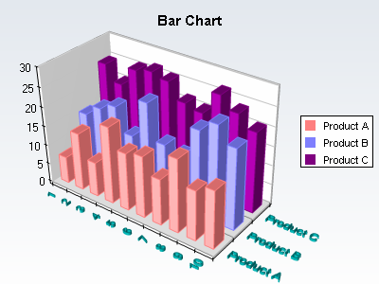
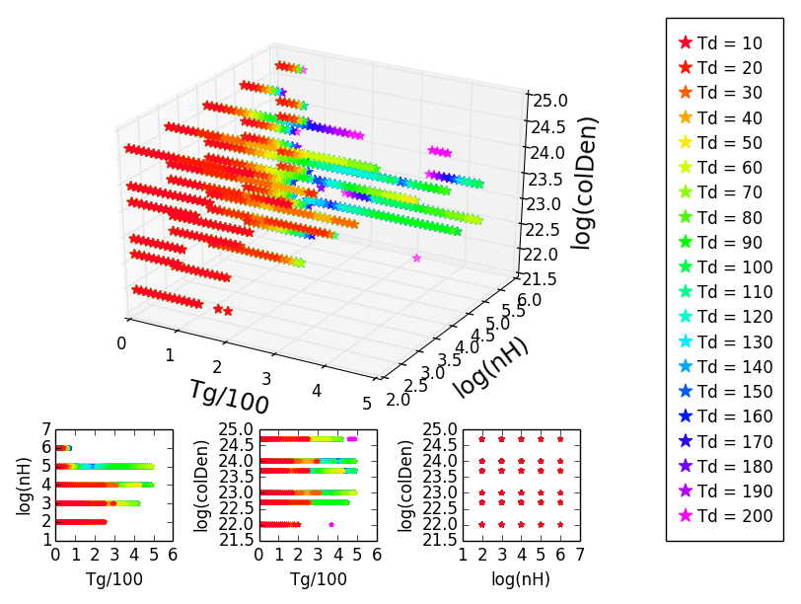
Why discuss good visualization practices?
src: www.chartdir.com
src: http://stackoverflow.com/questions/30235923/colors-lost-in-matplotlib-3d-scatter-plot

Slide 4
overview
Perception
Visual encoding
Good guidelines
Ggplot demos

Slide 5
Communication

Slide 6
Tufte

Slide 7
Two goals of visualization
Exploratory
Explanatory

Slide 8
Exploratory
Explanatory
Dive deep
Consider all interactions
As long as you can understand it use it
Summary of work
Keep it simple
Someone that knows nothing of your work must easily understand
Misinterpretation can destroy the momentum of your findings

Slide 9
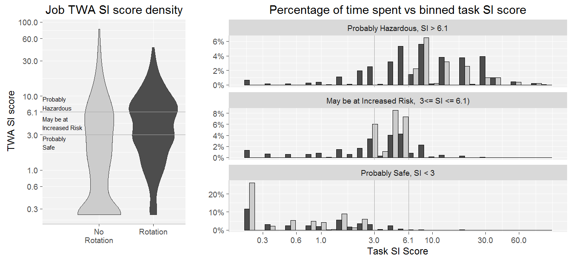
Exploratory
Explanatory

Slide 10
Exploratory
Explanatory
We want these ones

Slide 11
“Everything we hear is an opinion, not a fact. Everything we see is a perspective, not the truth.”
- Marcus Aurelius

Slide 12
How do we show our work?
So many options
Excel
Matlab
R ggplot2
Python (Matplotlib, Seaborn, Vincent …)
D3
Tableau
Illustrator (or free alternatives like Gravit)

Slide 13
Which is longer?

Slide 14
Which is longer? – lets make it easy

Slide 15
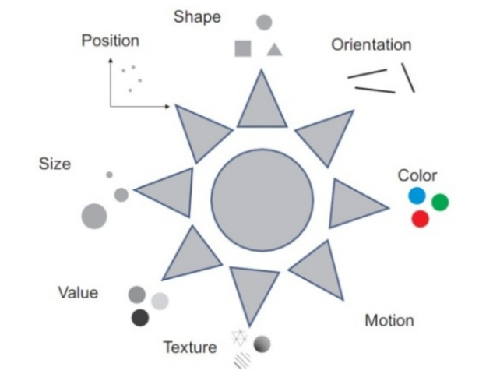
Visual encodings
src: Bertin 1983, representation
by Qeli 2007

Slide 16
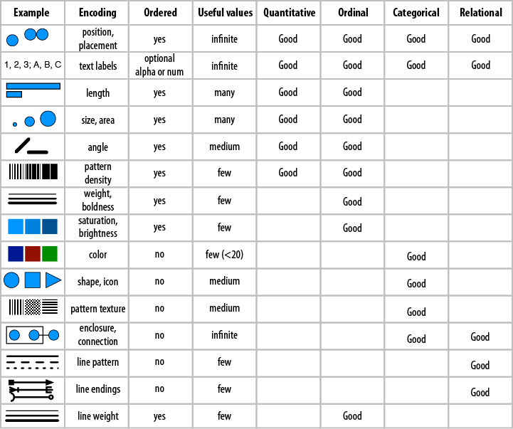
Visual encodings
src: Designing Data Visualizations

Slide 17
Visual encodings
A
B
A
B

Slide 18
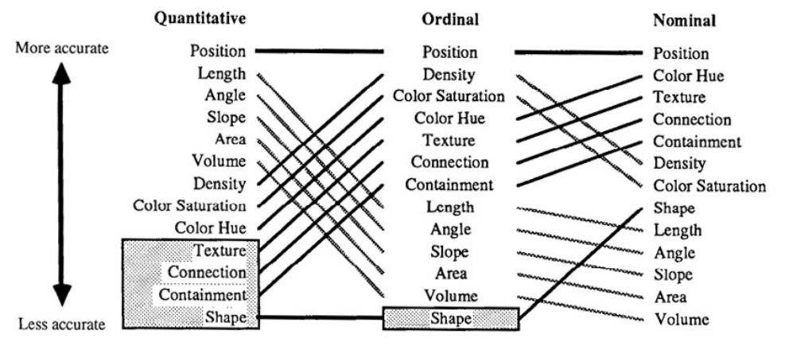
Visual encodings
For research, see Graphical Perception: Theory, Experimentation, and Application to the Development of Graphical Methods - Cleveland & McGill 1984
src: Mackinlay 1986

Slide 19
Visual encodings
src: gapminder.org

Slide 20

Visual encodings
Napoleon's disastrous Russian campaign of 1812
src: wikimedia.org

Slide 21
Redundant encodings
A1
B1
A2
B2
A1
B1
A2
B2

Slide 22
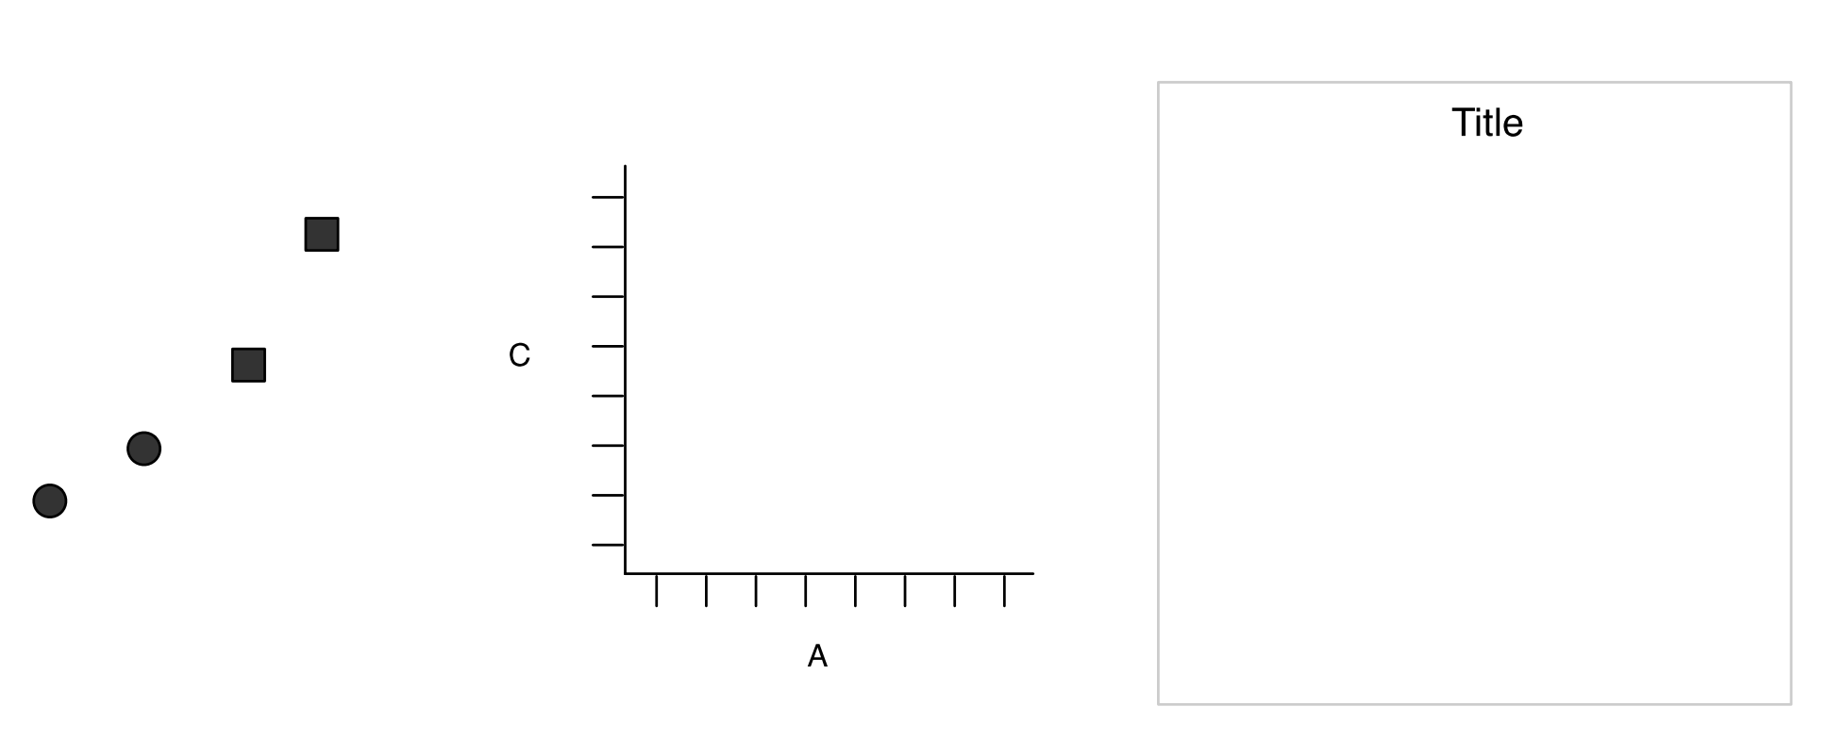
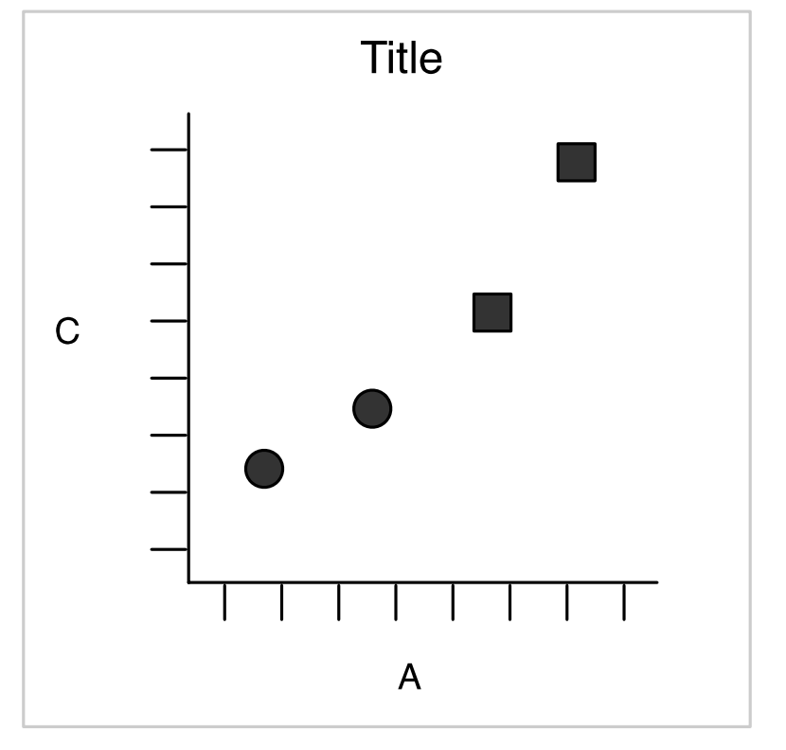
Grammar of graphics
Src: A Layered Grammar of Graphics - Wickham 2010

Slide 23
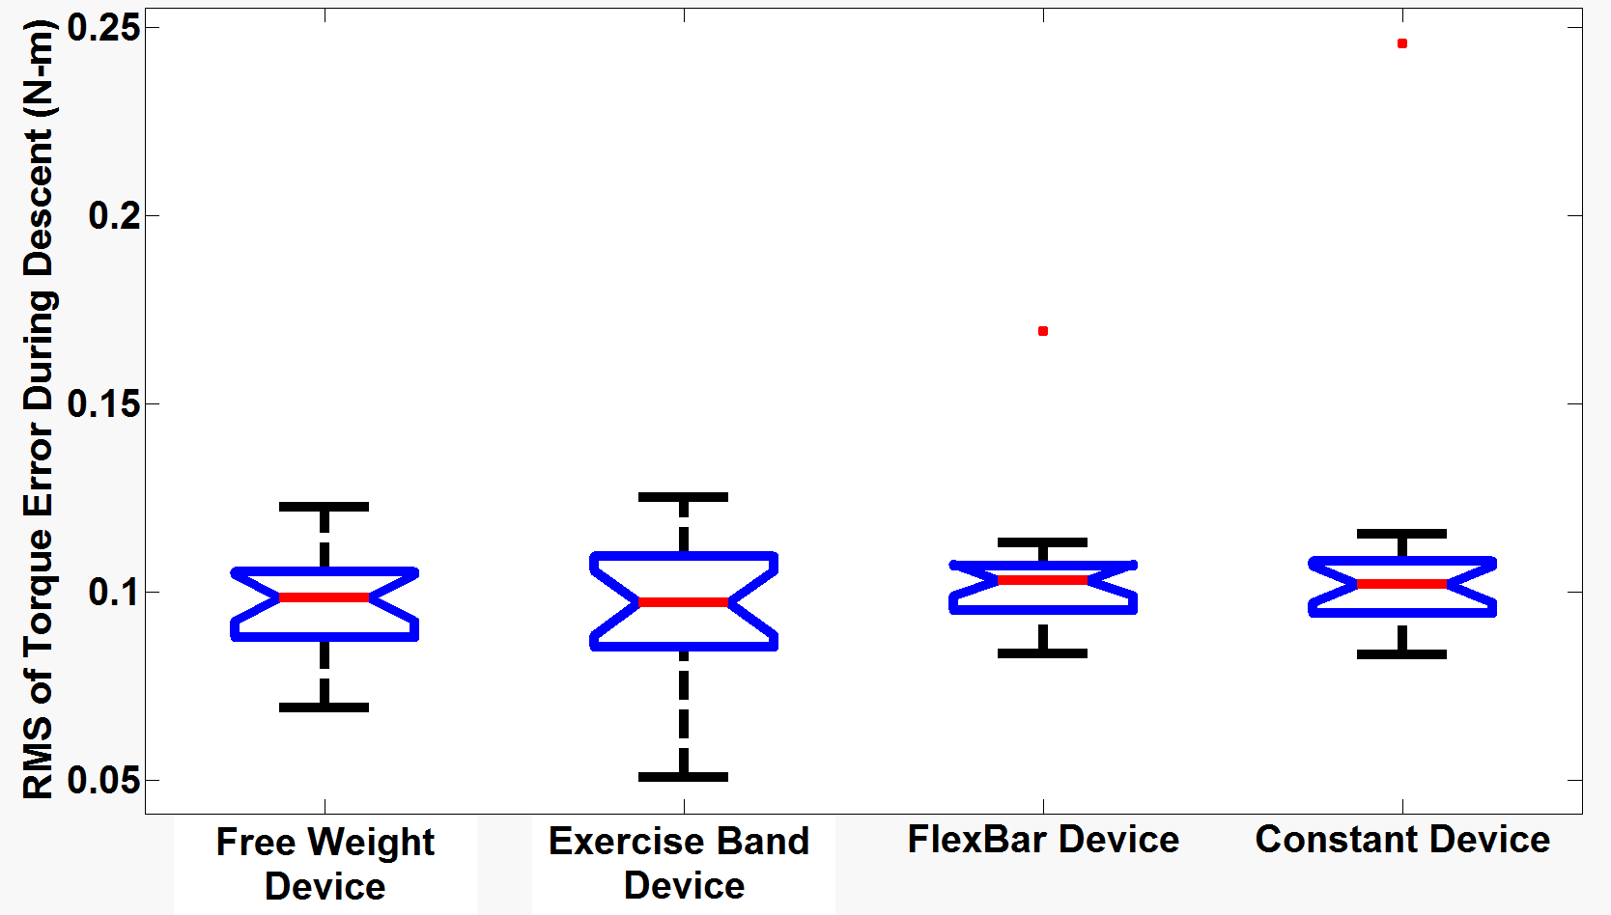
Example with Matlab

Slide 24
Aes

Slide 25
facets

Slide 26
jitter

Slide 27
Color & fill

Slide 28
Geom_text annotate, vline, hline

Slide 29
boxplot

Slide 30
histogram

Slide 31
Violin plot

Slide 32
corrmap

Slide 33
Chloropleth / heat map

